Slide 1
Measuring a Nation’s Income

Slide 2
Questions
What is Gross Domestic Product (GDP)?
How is GDP related to a nation’s total income and spending?
How is GDP corrected for inflation?
Does GDP alone measure society’s well-being?

Slide 3
Economics
Microeconomics
Study of how households and firms
Make decisions
Interact in markets
Macroeconomics
Study of economy-wide phenomena
Inflation
unemployment, and
economic growth (GDP, Gross national products)

Slide 4
Economy’s Income & Expenditure
Gross Domestic Product (GDP)
Measures the total income of everyone in the economy
Measures the total expenditure on the economy’s output of goods and services
For the economy as a whole, income equals expenditure because every dollar a buyer spends is a dollar of income for the seller.

Slide 5
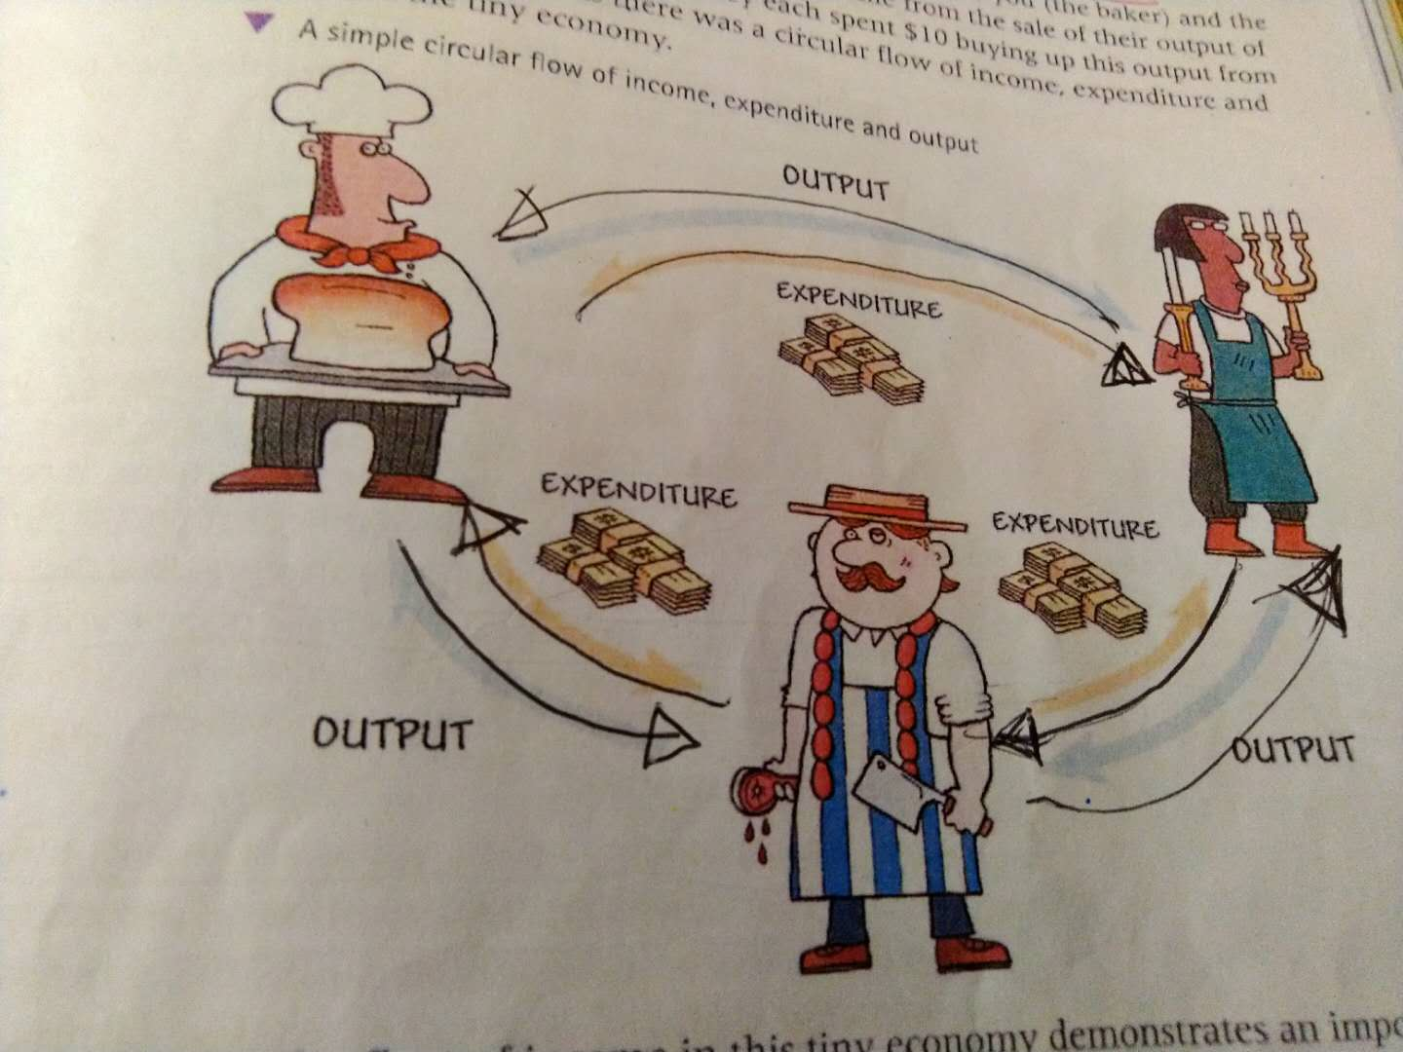
A simple circular flow of diagram

Slide 6
Expenditure = income
Candlestick maker spend $10 to buy meat from the butcher
Candlestick maker’s expenditure is $10
The butcher’s income is $10
Butcher spends $10 to buy bread from the bread maker
The butcher’s expenditure is $10
The bread maker’s income is $10
Bread maker spends $10 to buy from the candlestick maker
The bread maker’s expenditure is $10
The candlestick’s income is $10

Slide 7
Economy’s Income & Expenditure
Circular-flow diagram – assumptions:
Two Markets
The market for Factors of production Factors of production
The market for Goods and services
Households (owners of resources and consumers of goods and services)
Spend all of their income to Buy all goods and services
Firms (consumers of resources and producers of goods and services)
Pay wages, rent, profit to resource owners

Slide 8
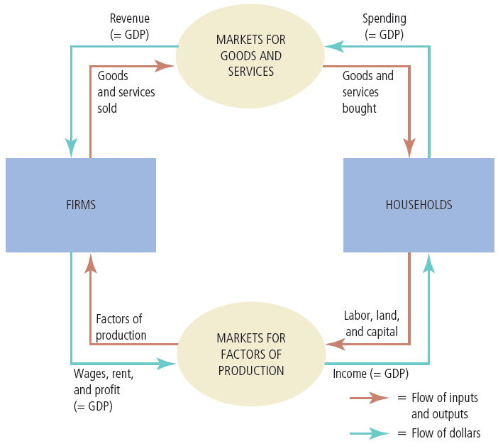
Figure 1
The Circular-Flow Diagram
Households buy goods and services from firms, and firms use their revenue from sales to pay wages to workers, rent to landowners, and profit to firm owners. GDP equals the total amount spent by households in the market for goods and services. It also equals the total wages, rent, and profit paid by firms in the markets for the factors of production.

Slide 9
End of class for F block, Feb. 20, 2019

Slide 10
The Measurement of GDP
Gross domestic product (GDP)
Market value of all final goods and services produced within a country in a given period of time.
“GDP is the market value…”
Market prices - reflect the value of the goods

Slide 11
The Measurement of GDP
“… of all…”
All items produced in the economy (within the countries geographic boundary)
And sold legally in markets
Excludes most items
Produced and sold illicitly (illegally)
Produced and consumed at home (such meals cooked by mom, cleaning done by kids)

Slide 12
The Measurement of GDP
“… final…”
Value of intermediate goods is already included in the prices of the final goods
“… goods and services…”
Tangible goods & intangible services
“… produced …”
Goods and services currently produced

Slide 13
The Measurement of GDP
“… within a country…”
Goods and services produced domestically
Regardless of the nationality of the producer
“… in a given period of time”
A year or a quarter

Slide 14
End of class, 2-19-19 G block

Slide 15
Three ways to measure the GDP
The income method
The total income earned from the sale of factors of production for the production of the goods and services
The expenditure method
Total amount spent on the final goods and services produced within an economy
The output method (valued-added approach)
The total value from the sale of all final goods and services

Slide 16
Check Your Understanding
Are these activities part of GDP?
Mrs. Miller picks flowers in her garden.
Fruits are sold on the market.
Patients, hurt in a car accident, are treated in a hospital.
Pensioners do community work for free.
A car manufacturer buys brand new tires to put on brand new cars
A mom spends all day caring for her child and cooking meals for her family
A mom goes to work, makes money and pay a babysitter to watch her child

